Slide 1
Opening New Gyms In Delhi
By: Prashant Thakur
(Aug-2020)

Slide 2
Why Budget Gyms are necessary
64% of Indian don’t exercise
On an average people in Delhi dine out 6 times in a month, highest in India
Indian food is prepared using oil and spices
Out of Indian who exercise:
67% do brisk walking
26% do yoga/pilates/CrossFit
11% who do cardio and team sports (e.g. football, cricket)
10% who do bodyweight exercises
Indians find exercises involving gyms and fitness classes tend to be more expensive

Slide 3
Data acquisition & cleaning
https://timesofindia.indiatimes.com/life-style/health-fitness/health-news/64-per-cent-indians-dont-exercise-study/articleshow/70038656.cms
https://nrai.org/delhiites-dine-out-six-times-a-month-but-bangaloreans-spend-the-most/
https://en.wikipedia.org/wiki/Category:Neighbourhoods_in_Delhi
Foursquare API, for date on venues in different neighbourhoods
Cleaned data contained 7 features.

Slide 4
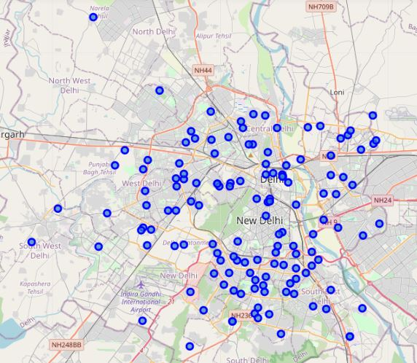
Map of neighbourhoods of Delhi

Slide 5
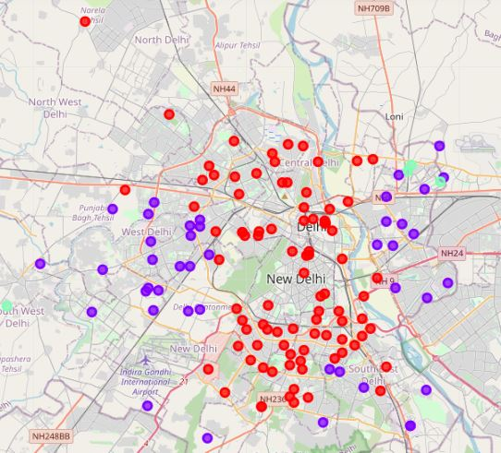
Clustered map of neighbourhoods
There are 91 red markers which represents neighbourhoods with no gyms in 10 kms vicinity
There are 43 purple markers which represents neighbourhoods with 1 to 3 gyms in 10 kms vicinity
There are 4 green markers which represents neighbourhoods with more than 3 gyms in 10 kms vicinity

Slide 6
Conclusions & Future direction
91 neighbourhoods can be recommended to open a budget gym
Central Delhi has less concentration of gyms
Results can also be used by retailer of sports and fitness equipments, to advertise the products in neighbourhoods of high concentration of gyms

